Slide 2
Agenda
BACKGROUND AND OBJECTIVE
OVERVIEW OF MOVIE DATABASE
DESCRIPTIVE AND EXPLORATORY DATA ANALYSIS
DATA MODELING
INSIGHTS

Slide 3
Background and Objectives
BACKGROUND
The Fox Brothers wants to identify the key factors that drives the success (7+ rating) or failure of a movie All while adopting to a data-driven methodology and overhauling their current approach towards movie production
OBJECTIVES AND KEY QUESTIONS
Knowing that many movies release each year, is there a way to identify trends and factors that brings public to the theatres? Does social media and critics play an important role in assessment of the goodness of a movie?
To analyze 90 years of movie rating and associated information in order to come up with the right mix of quantitative factors that would help Fox Brothers to plan for a beneficial future investment

Slide 4
Agenda
BACKGROUND AND OBJECTIVE
OVERVIEW OF MOVIE DATABASE
DESCRIPTIVE & EXPLORATORY DATA ANALYSIS
DATA MODELING
INSIGHTS

Slide 5
Overview of Movie Database
HUMAN FACES IN POSTER
PRIMARY ACTOR NAME
HIS FACEBOOK LIKES
SECONDARY ACTOR NAME
HIS FACEBOOK LIKES
THIRD ACTOR NAME
HIS FACEBOOK LIKES
DIRECTOR NAME
HIS FACEBOOK LIKES
TOTAL CAST FACEBOOK LIKES
MOVIE FACEBOOK LIKES
IMDB RATING SCORE
CONTENT RATING
BUDGET
COUNTRY
COLOR
ASPECT RATIO
LANGUAGE
GROSS
PLOT KEYWORDS
MOVIE TITLE
TITLE YEAR
DURATION
GENRES
MOVIE IMDB LINK
SOCIAL MEDIA VARIABLES
VARIABLES RELATED TO MOVIES
OTHER VARIABLES
5000+ MOVIES
CRITICS VARIABLES
NUMBER OF VOTED USERS
NUMBER OF REVIEWS FROM CRITICS
NUMBER OF REVIEWS FROM USERS

Slide 6
Agenda
BACKGROUND AND OBJECTIVE
OVERVIEW OF MOVIE DATABASE
DESCRIPTIVE & EXPLORATORY DATA ANALYSIS
DATA MODELING
INSIGHTS

Slide 7
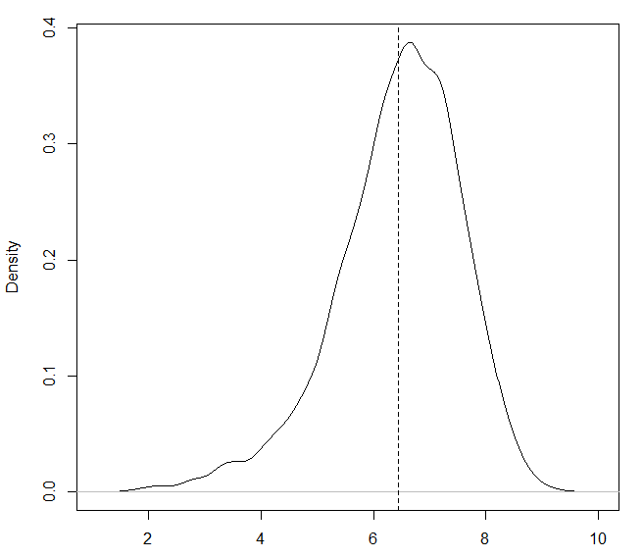
Descriptive & Exploratory Data Analysis
As a first step, it remains important to check for the normality of the response variable to assess any future need of transformations
The distribution of ratings is approx. normal, with little bit of skewness

Slide 8
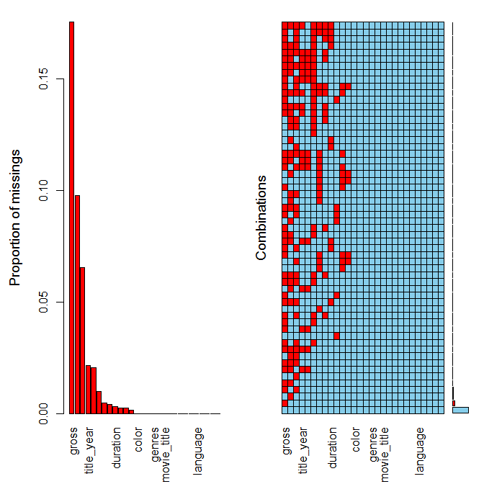
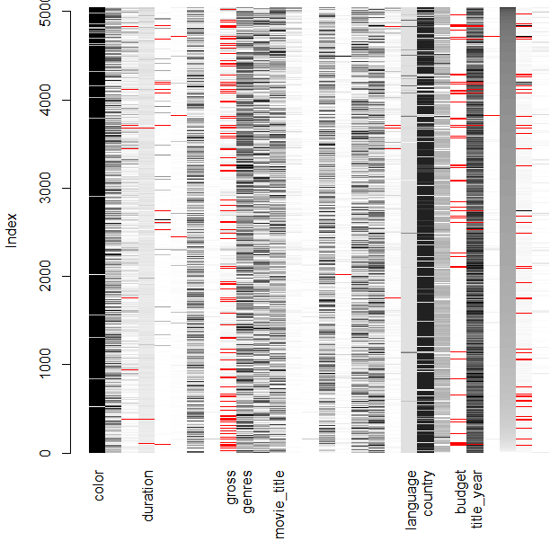
Descriptive & Exploratory Data Analysis contd..
The aggregation plots, matrix plots and margin plots (next slide) help in assessing what imputation method to undertake

Slide 9
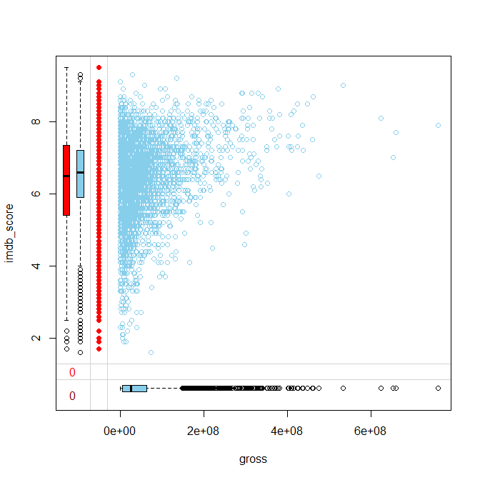
Descriptive & Exploratory Data Analysis contd..
The missing variables belong to either MAR or MCAR but MNAR, hence it hints at imputing values with sophisticated algorithms like Rpart, MICE or KNN

Slide 10
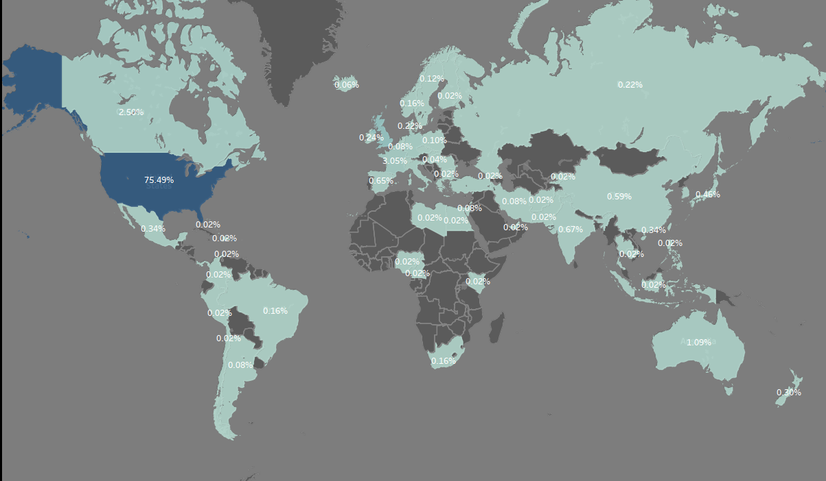
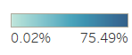
Descriptive & Exploratory Data Analysis contd..
~75% of the movies in our database are being produced in US

Slide 11
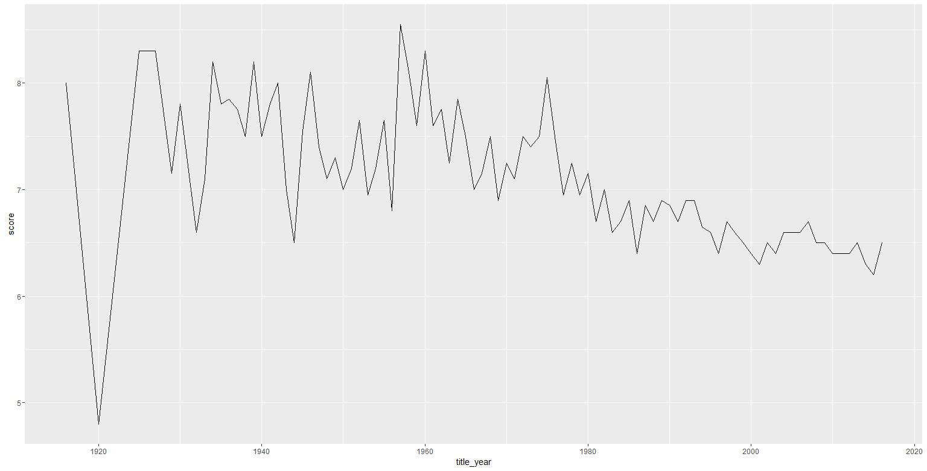
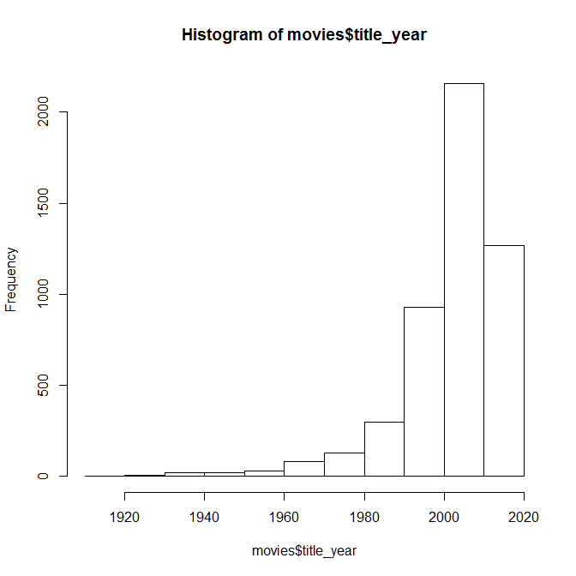
Descriptive & Exploratory Data Analysis contd..
Score = mean of IMDB Rating
More than 50% of our database contain movies post year 2000 with an yearly average rating below 7.0

Slide 12
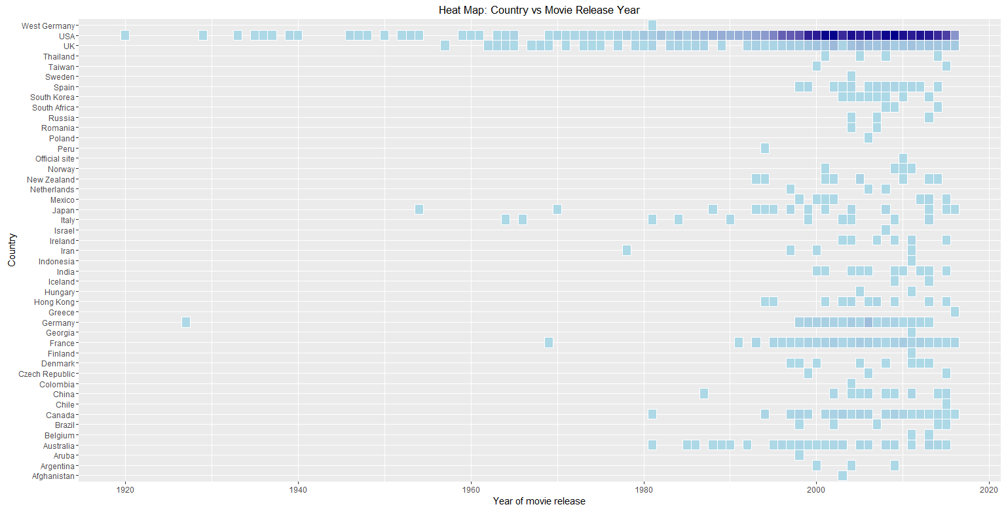
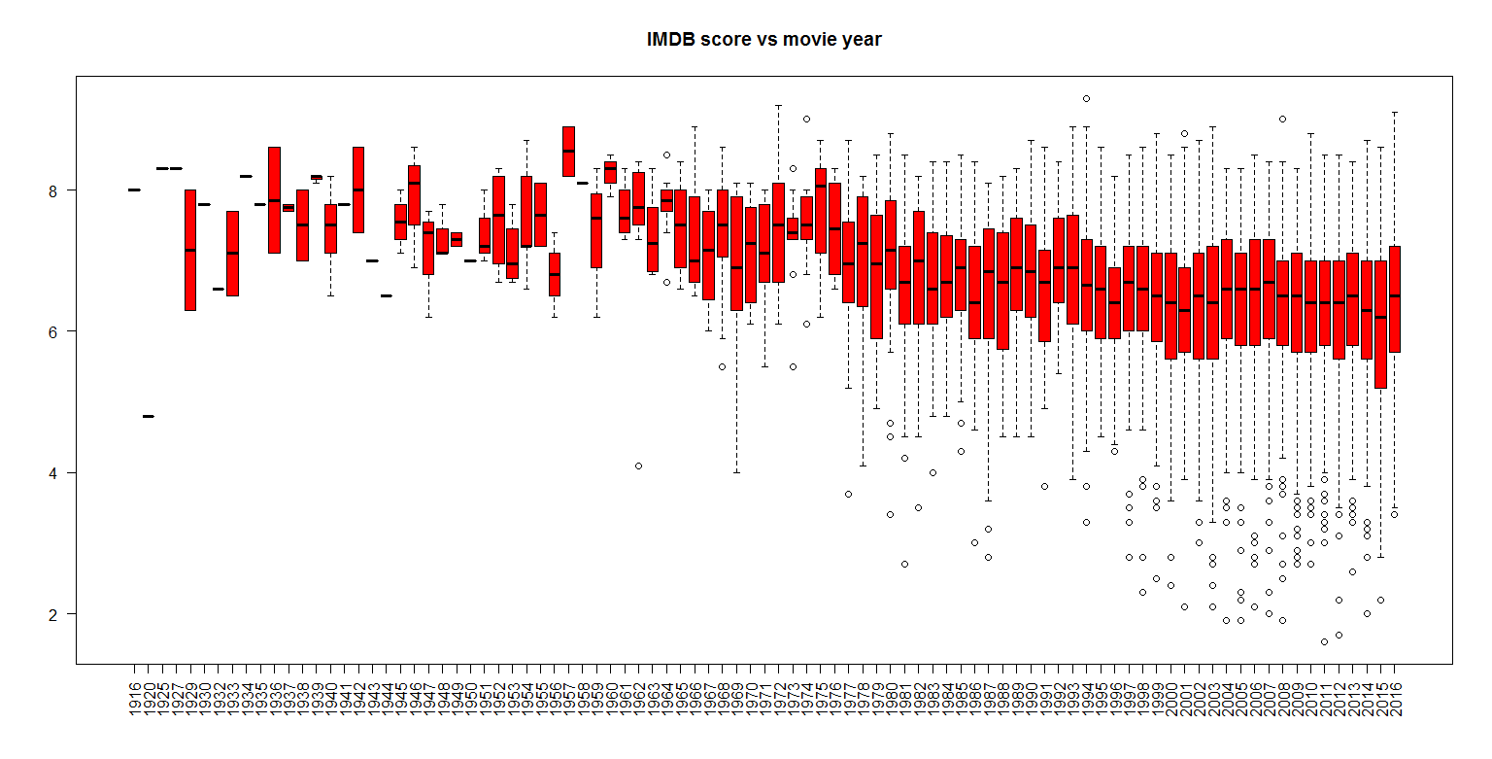
Descriptive & Exploratory Data Analysis contd..

Slide 13
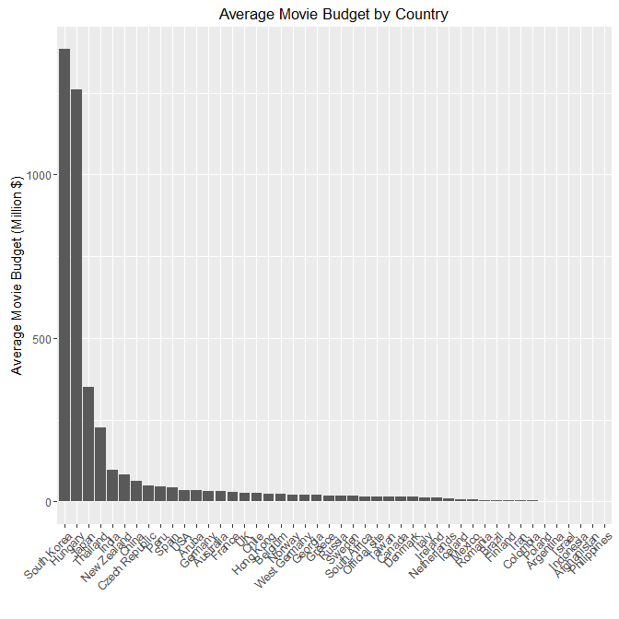
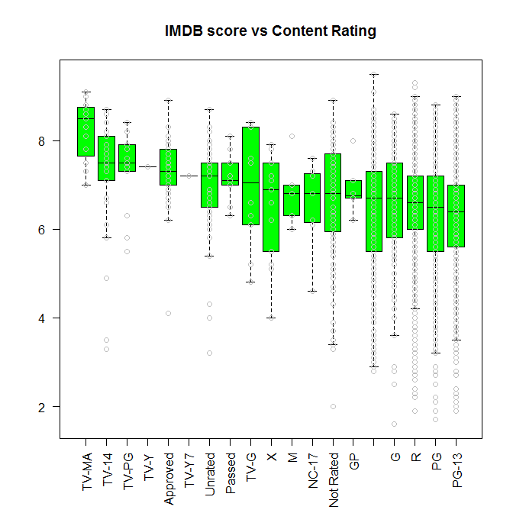
Descriptive & Exploratory Data Analysis contd..
Movies with content which are unsuitable for general audience are rated the highest by almost all the veiwers

Slide 14
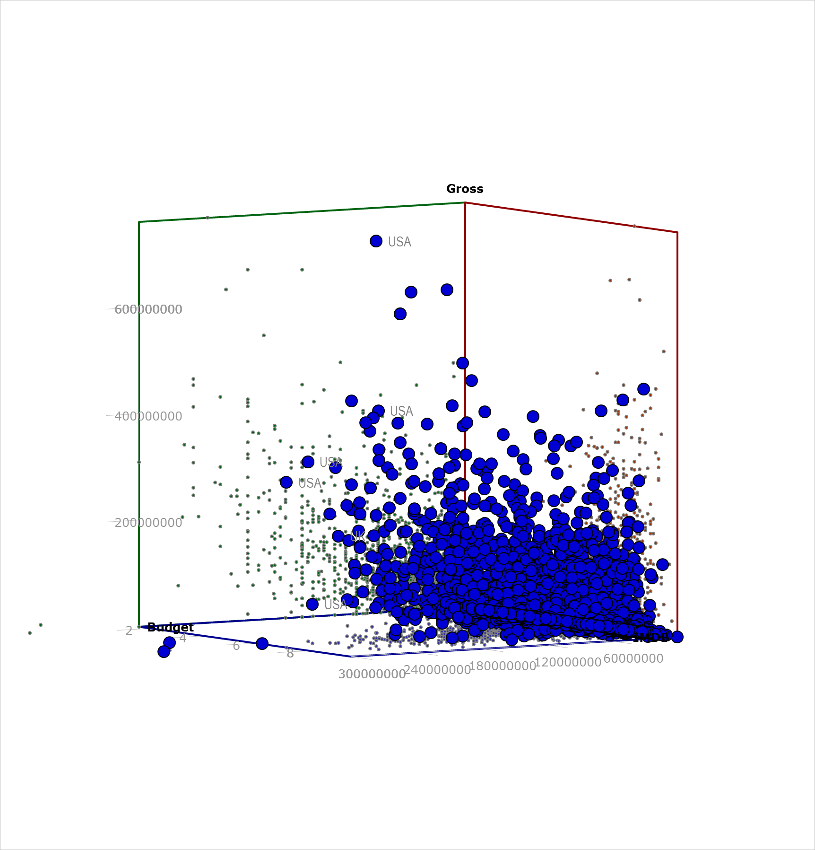
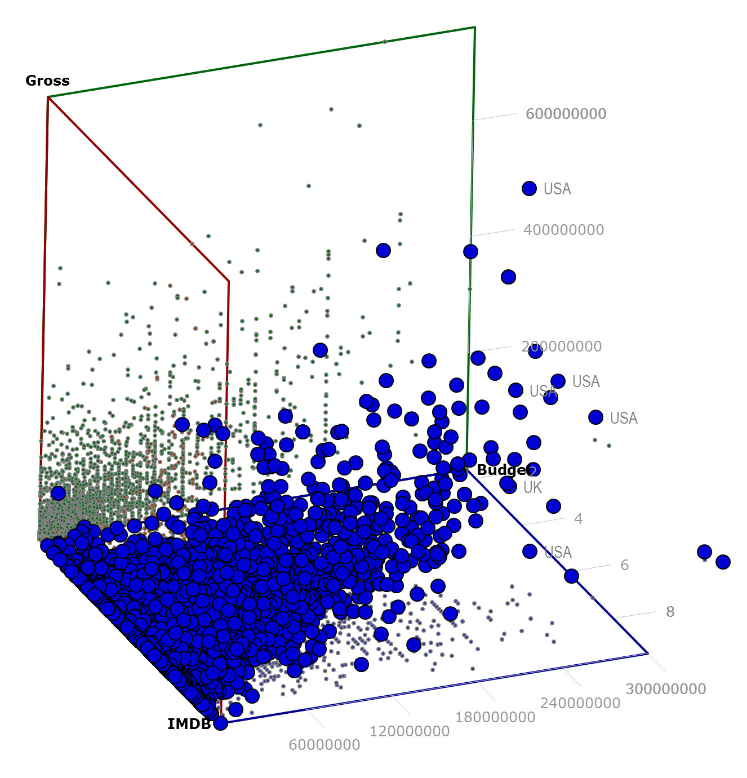
Descriptive & Exploratory Data Analysis contd..
Movies that are liked by people doesn’t necessarily seems to generate much revenue, indicating chances of piracy

Slide 15
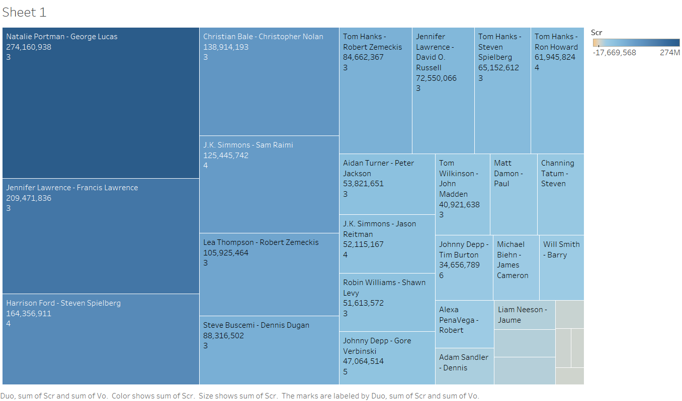
Descriptive & Exploratory Data Analysis contd..
Actors with versatility are the top profit drivers

Slide 16
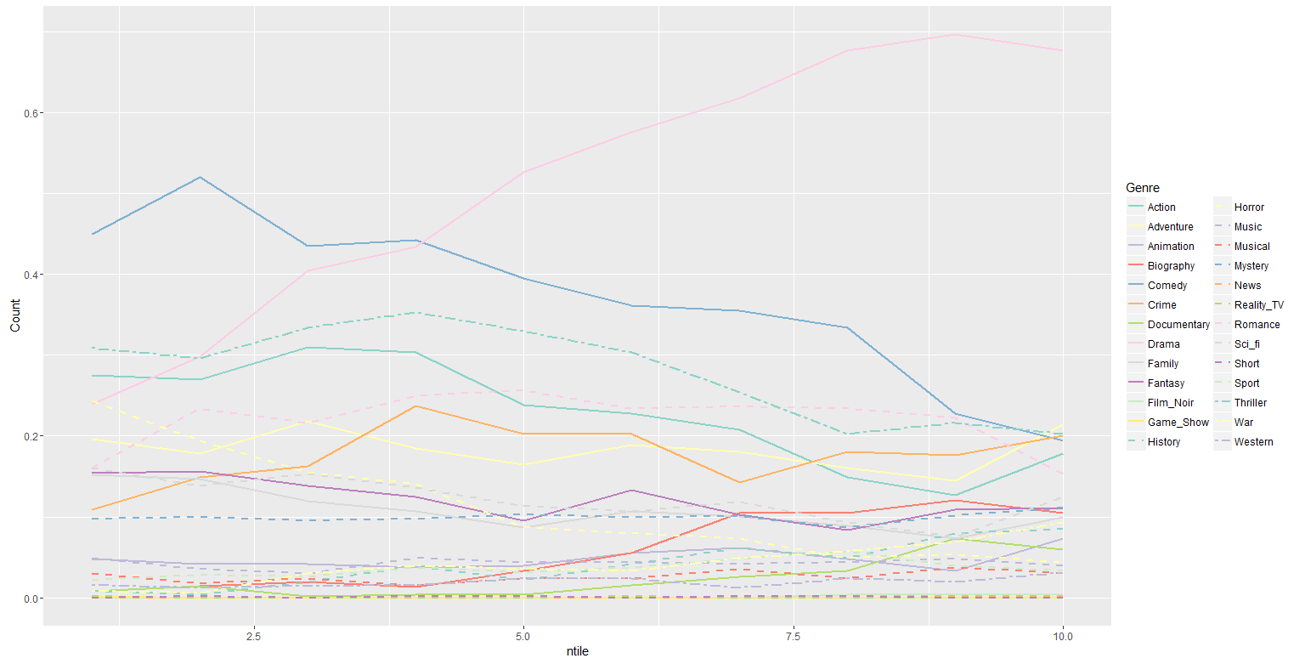
Descriptive & Exploratory Data Analysis contd..
Drama genre movies and series are significantly liked by everyone; Similarly Biography and Documentary genre

Slide 17
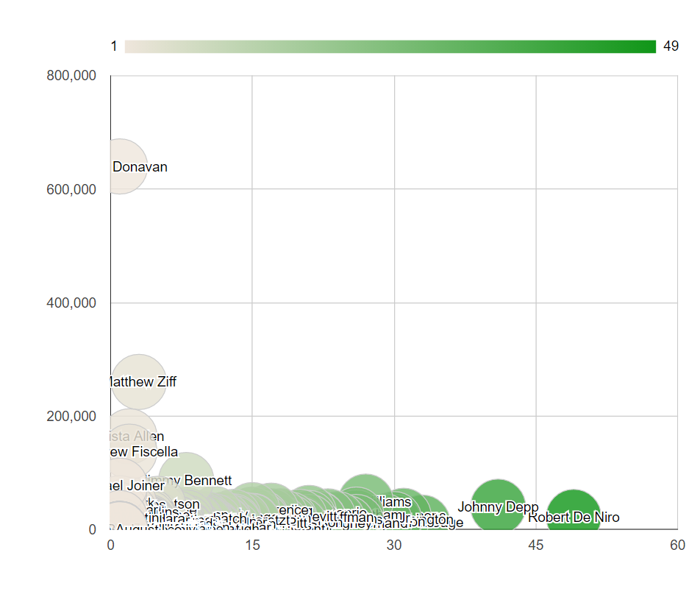
Descriptive & Exploratory Data Analysis contd..
Facebook Likes
Appear Count
Actors who are working in more # movies doesn’t seems to have lot of social media fan followers

Slide 18
Agenda
BACKGROUND AND OBJECTIVE
OVERVIEW OF MOVIE DATABASE
DESCRIPTIVE & EXPLORATORY DATA ANALYSIS
DATA MODELING
INSIGHTS

Slide 19
Data Modeling
Step – Wise method to identify important variables
Data Cleaning
Data Transformation
Data Selection for prediction modeling
Prediction Modeling
Removal of duplicate records / entries
Based on least Mean absolute percent error select the best imputation method applicable to the data (KNN or MICE)
Calculate “relative likes” getting the Facebook likes meaningful
Since actor / directors name won’t help in prediction, taking their aggregated count might, hence the call
Transform the variables which are skewed and have outliers (using box-cox transformations and influential plots for identification)
First, omit correlated independent variables
Omit the columns which have low variance
Interpret the results and give recommendations

Slide 20








Data Modeling contd..
WHY “RELATIVE LIKES” MAKE SENSE?
It would quantify Actor / Directors Facebook likes based on their local competition This would enable better comparison between individuals from two different regions
Superstar Actor A
Average Actor B
130 M
330 M
Suppose, A
= 600
<
and B
= 1500
Average #Likes an Actor from this country gets = 500
>
and B
But, A
= 2.54
= 0.75
Average #Likes an Actor from this country gets = 2k

Slide 21
Data Modeling contd..
Imputed + Transformed
Linear Regression
Just Imputed
Logistic Regression
Model Selection
Final Model to be used
Neither Imputed nor transformed
KNN
Compare AIC, BIC, Adj. R2 and SSE
Classification
Prediction
Just Transformed
Random Forest
KNN (7) with just imputed data which explained
OLS with just imputed variable
Random forest and KNN are for classification purpose and not for statistical prediction

Slide 22
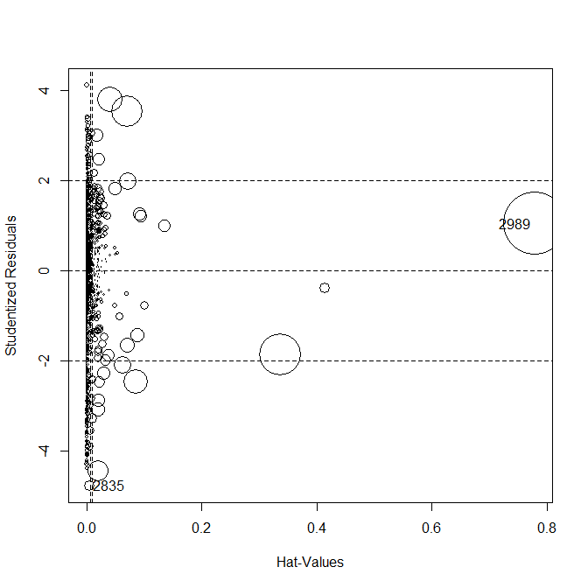
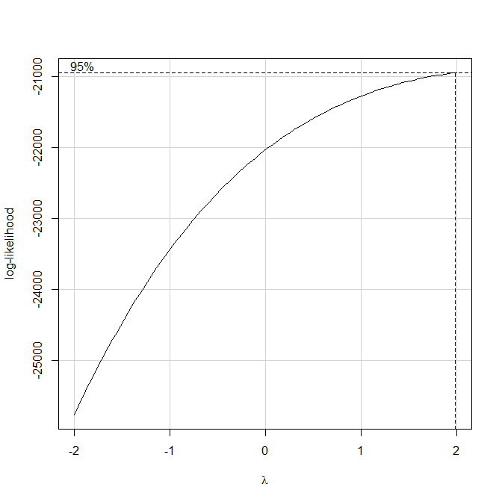
Data Modeling contd..
With influence plots it was found that one of the data points (#2989) had a unique situation where the production house invested 12$ + Billion in a 7 point rated movie and generating a revenue of 2$ Million ~ 99.6% loss on investment
With Box-Cox transformation the ʎ is estimated to be 2, since the response variable was negatively skewed; Similarly, ʎ for all the other skewed variable were calculated

Slide 23
Agenda
BACKGROUND AND OBJECTIVE
OVERVIEW OF MOVIE DATABASE
DESCRIPTIVE & EXPLORATORY DATA ANALYSIS
DATA MODELING
INSIGHTS

Slide 24
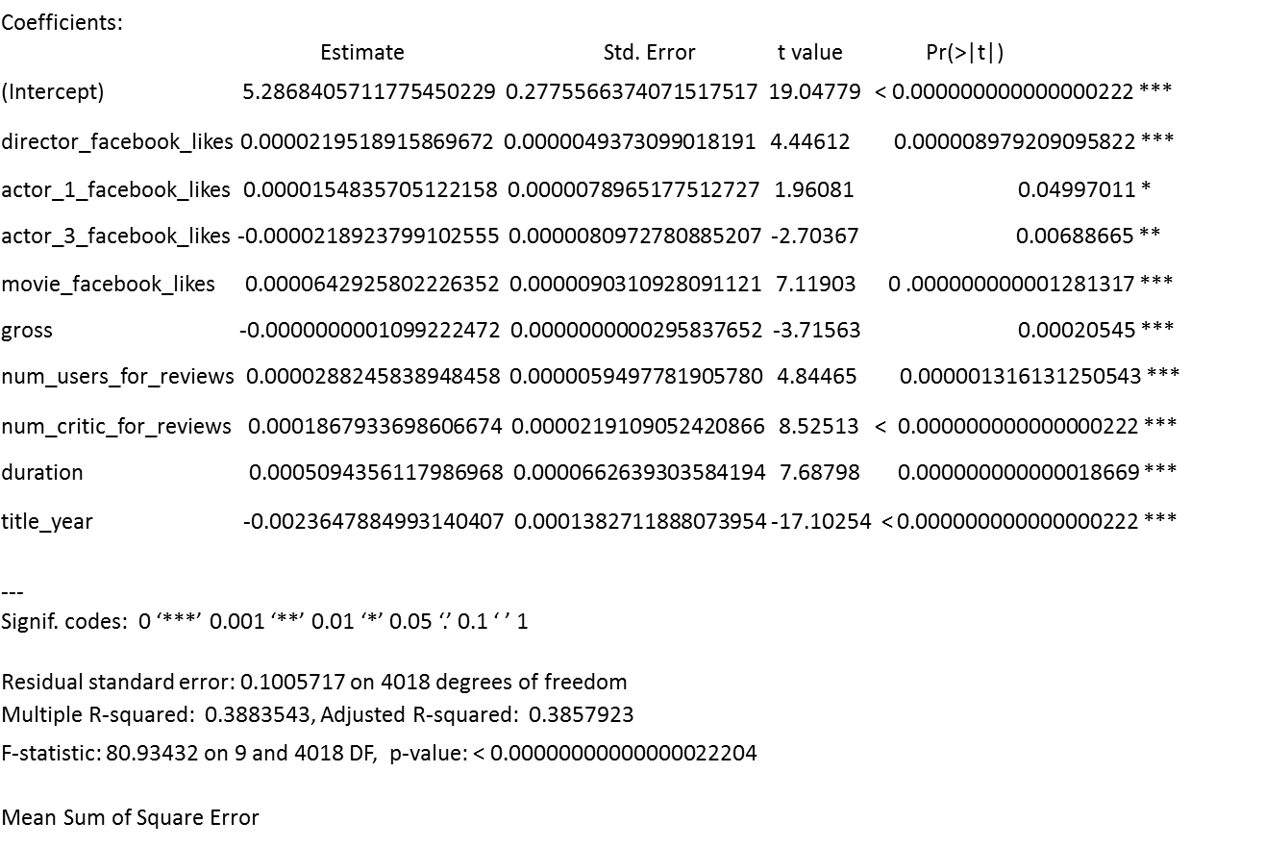
Insights
These are the set of most important factors that has impact on the ratings:
Title Year of the movie -> negative impact i.e. with every 5 years increase in the release period of the movie, the rating decreases by .1 unit
Duration of the movie -> positive impact i.e. with every 20 mins addition in the movie the rating increases by .1 unit
# of Critics -> positive impact i.e. with every additional 53 critics reviewing the movie, the rating increases by .1 unit
# movie Facebook likes -> positive impact i.e. with every additional 166 times likes with respect to the average in the region, the rating increases by .1 unit
Gross Revenue -> negative impact i.e. with every 100 million dollars increase in the revenue, the rating would decrease by .1 unit
The response variable was scaled to .01 to 1.0; Positive impacting variables drives the movie towards the success

Slide 25
THANK YOU
ANY QUESTIONS?

